Slide 1

Microsoft Fabric
May - 2025
Notes:
Introduction : To gain an understanding of MSF Fabric, how it offers unique features and benefits for various applications
Explore : The Various components Which Make Up Fabric
Build : Wear the Data Analyst Persona and learn how Fabric can meet your needs in one platform.

Slide 2
What we will cover
Session 1 | Introduction to Microsoft Fabric
A | Challenges Faced by different data professionals
B | What is Fabric
C | The Challenges Fabric Solves
D | Set Up Fabric *
E | Different Fabric Persona
F | Overview of Workloads
G | Overview of One Lake *
I | Ingest Data Into your Lakehouse and Create Views *
J | Persona Experiences : Build a Semantic Power BI Model, ML Model *
Session 2 | Build with the TM: Creating a Power BI report from Fabric data *
Session 3 | Assignment Details
Notes:
Introduction : To gain an understanding of MSF Fabric, how it offers unique features and benefits for various applications
Explore : The Various components Which Make Up Fabric
Build : Wear the Data Analyst Persona and learn how Fabric can meet your needs in one platform.

Slide 3
Introduction to Microsoft Fabric

Slide 4
Fact
of organizations believe AI will give them a competitive edge
87%
Source: MIT Sloan Management Review
Notes:
After years of disruption driven by the pandemic and shifting economic landscape, industries are continuing to transform quickly, and AI technology only further expedites these transformations. ​
​
What sets AI apart from prior technological advances is its remarkable capacity to enhance our cognitive abilities – enabling us to think, reason, learn, and express ourselves. We believe AI offers a unique array of advantages that can be harnessed by organizations across all sectors.
A recent study found that 87% of leaders believe AI will give their organization a competitive edge. ​
​
The question every leader is asking themselves right now is this: ​
​
How will my organization seize the full potential of AI, while safeguarding my business, data, and employees?

Slide 5
But AI is only as good as the data it’s trained on
44% of leaders intend to implement data
modernization efforts
in 2024 to take
advantage of GenAI
91% of leaders report their organizations have increased investment in data and analytics
72% of leaders agree that data problems are the most likely factor to jeopardize AI/ML goals
MIT, Becoming an AI-driven enterprise, September 2022
HBR, Why Every Modern Enterprise Organization Needs Insight-Driven Marketing, June 2023
PWC, 2024 AI Business Predictions, 2023
Notes:
Understanding that AI is here to shape our technological landscape, we’ve identified 3 other trends we believe will continue to heavily shoulder disruption moving forward:
The 1st is the knowledge that 91% of leaders have reported increasing investment in data and analytics throughout their organization. While we’ve seen a rise in digital transformation and data estate modernization in recent years, it is essential for businesses to have a data and analytics strategy in order to maximize the value of their data and turn it into a competitive advantage.
Because AI solutions are only successful when they’re built and trained on high quality data, organizations that have not made strides to effectively manage and leverage their data will struggle to compete. 72% of leaders agree that it is problems with their data that are most likely to jeopardize their AI and ML efforts, so businesses need a way to clean and prepare their data for innovation if they want to even have the ability to explore, experiment, model and build AI and ML applications.
As we’re seeing unfold today, a large part of maintaining a competitive advantage is through the use of AI. AI gives life to all that data we’re creating, and the 3rd trend we’re seeing is that, in 2024, 44% of leaders intend to implement data modernization efforts to better take advantage of generative AI.
In organizations that have vast amounts of data, the reality is that this data largely remains underutilized, if not used at all. A Forrester research report confirms that between 60-70% of enterprise data goes unused. A survey done by Accenture notes that only 32% of reported companies can realize tangible and measurable value from data, while only 27% said their analytics insights and recommendations are actionable, leaving the majority underutilizing their data and analytics.
Exponential growth in data can bring more opportunities for enterprises to achieve insights that deliver high business value. However, the current rate of derived value from data causes “data value gap” that represents missing potential from data that businesses are not currently leveraging. This leaves a lot of opportunity on the table as companies with gaps in their data potential value won’t be able to improve their operational efficiency, make more informed decisions, or create new products and innovation, hindering their overall ability to pivot.
By becoming a data-driven organization that foundationally scales their analytics, your data quality will increase and create efficiencies that can begin to transform your core business and operations.
Data Value & Data-led Transformation Services | Accenture
Source: “Closing the data value gap,” Accenture, May 28, 2020
“The Forrester Wave: Big Data Hadoop Distributions, Q1 2016”, Forrester, January 19 2016

Slide 6
Different Data Professionals
Data Engineers
Data Architects
Data Analysts
Data Steward
Data Scientists
BI Analyst
Data Strategist
Data Consumer
Notes:
Data Product Manager
ML Engineer
Data Storyteller
Data Analytics Engineer
Data Visualization Specialist
CDO
Data Steward : Managing data quality, governance, and lineage
Data Architects : Designing and overseeing the overall data architecture
D.A : Exploring data and creating reports and dashboards D.E : Ingesting, transforming, and preparing large volumes of data. Make data available and optimized for downstream analytics.

Slide 7

Today’s data value creation challenges
Siloed systems and poor-quality data
Costly integration and ongoing maintenance
Lagging BI and AI adoption
Data governance and security risks
Technical platforms requiring advanced skills and limited resources
Notes:
Despite understanding the need to invest in advanced digital transformation and data and analytics capabilities, organizations face many obstacles when trying to scale their data and analytics:
It’s extremely difficult to operate and govern hundreds if not thousands of databases, and:
Data and systems are generally disparate, siloed, and lack interoperability
Disparate data systems or lacking data estate strategy can frequently lead to poor quality data that’s hard to extract value from
Platforms are technical in nature and require advanced analytics skills
It can be next to impossible to gain BI or AI adoption across the organization, in turn making it hard to streamline data sharing and accelerated insight discovery across teams and LOBs
Costly integration tax and ongoing maintenance can be cumbersome
Large amounts of data come with greater security and governance risks, especially as it gets shared more widely across an organization, and
There is a need to deliver on the promise of analytics, but resources are limited
Integrating fragmented data and systems can be difficult and expensive, with technical platforms requiring advanced analytical skills. Because of that, the adoption of business intelligence across many organizations can be challenging to achieve and error-prone, especially due to high security risk and limited resources.

Slide 8


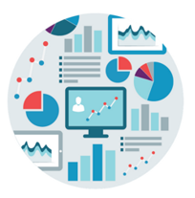
The starting line: A complex, organically evolved data estate
Several
1
Business team
Business team
Business team
Data copies and infrastructure inefficiencies
Tech team
Tech team
AI modeling
AI modeling
2
Data transformation and BI
Data transformation and BI
Data Management
Data Management
Limited interoperability
Storage
Storage
Ingestion
Ingestion
3
Enterprise Data Sources
Multi-Cloud | On-Premise | External
Data exposure risks
Notes:
Data transformation is like a team sport. Consider your favorite team: each player brings a set of unique skills and experiences that must work together seamlessly. The same can be said about data transformation. From data-backed insights to secure, reliable governance, every part of a data strategy has its place to ensure a winning strategy.
Although an organically evolved data estate can seem great in theory, it enables a plethora of inefficiencies and data exposure risks including, but not limited to, the fact that a siloed data estate prevents good AI adoption and reduces connectedness and the chances of success.
When your organization has data copies and infrastructure inefficiencies, your teams have:
Increased costs by having to maintain and manage multiple copies of the same data
Difficulty making decisions because of inaccurate data, and
Systems that are hard to use because they are too technical in nature
Limited interoperability is bad for your bottom line, as it leads to:
Slower and less efficient business operations due to relying on manual data transfers and inefficient workarounds
Customer integrations or middleware solutions to connect systems which can be expensive to develop and maintain, and
Missed opportunities that limit organizations from taking advantage of new technologies and services
In addition to limited interoperability having a negative impact on your bottom line, data exposure risks are bad for business because:
Theft or compromise of sensitive or confidential data
Non-compliance with regulations, resulting in legal consequences and fines, and a
Decrease in trust with customers, partners, and stakeholders

Slide 9
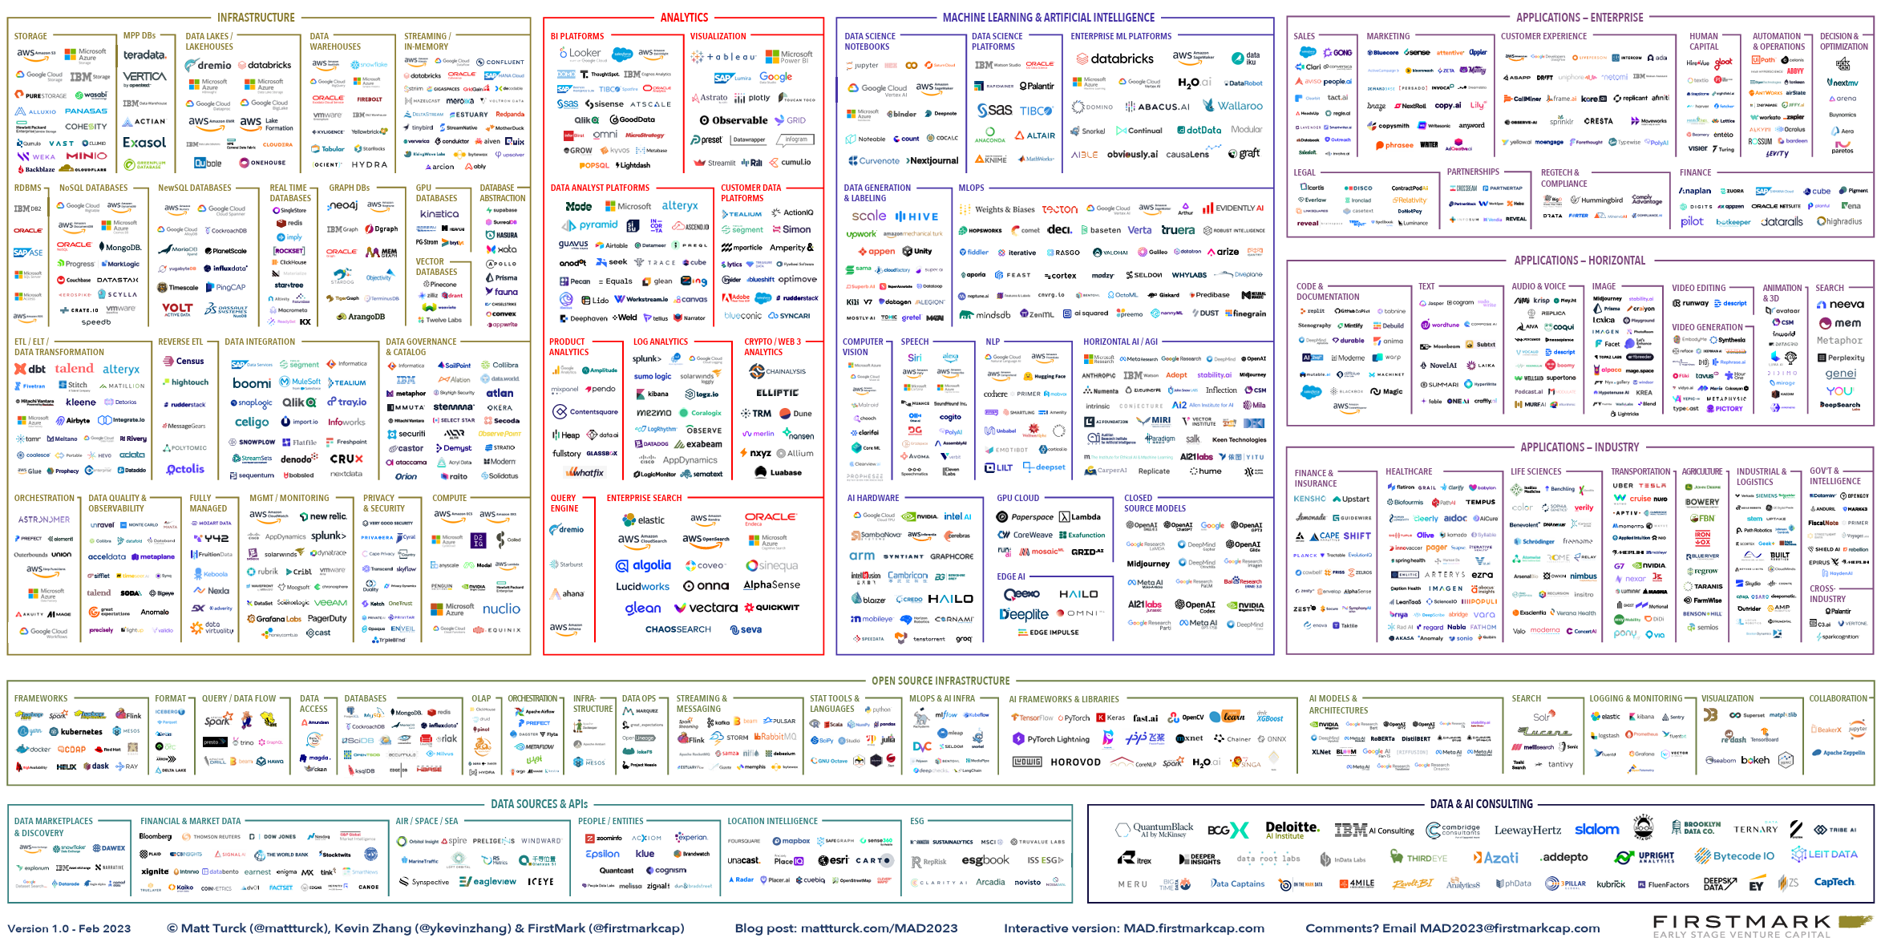
Customers enhancing their data estate face immense complexity
Notes:
For organizations trying to streamline and advance their data estate, the burden is often on you to search through the thousands of data and AI offerings, find the right set of offerings, figure out how to integrate them, and do it in such a way that is scalable and can evolve over time. Most data leaders would rather focus on the outcomes of their tools rather than spend all their time integrating specialized solutions and maintaining their data estate.
The data platform landscape is too complex with too many vendors and tools. Integrating them and implementing data governance is too cumbersome and complex.
The solution/answer is an Unified Data Platform with built-in integrations and unified governance – Microsoft Fabric

Slide 10







Existing Microsoft Products
Many Products
Different Experiences
Purview
Proprietary and Open
Azure AI
Dedicated and Serverless
Power BI
PaaS and SaaS
Synapse DW
Different Business Models
Kusto
Steep Learning Curves
Synapse Spark
Deep Expertise Needed
Data Factory
High Integration Effort

Slide 11

Microsoft Fabric
The data platform for the era of AI
From To
Multiple analytics services Unified stack
Disconnected data sources All the data in one place
Isolated application Entire estate
Gen AI bolt on Gen AI built in
Notes:
Microsoft Fabric is a unified, cloud-based data platform that delivers data management and analytics as a software as a service (SaaS).
Fabric provides end-to-end data services, from data ingestion to visualization.
Fabric combines components from Microsoft Azure and other services to provide a unified user experience.
Fabric connects seamlessly with Azure, enhancing Azure data processing and analytics capabilities.
Organizations of all sizes benefit from Fabric, such as by reducing complexity and improving decision-making.
Fabric use cases span industries, including retail, healthcare, and sustainability.

Slide 12













Microsoft Fabric
Data
Factory
Data
Engineering
Data
Warehouse
Data
Science
Real-Time
Intelligence
Power
BI
Partner &
Industry
workloads
Databases
Copilot in Fabric
OneLake
Microsoft Purview
UNIFIED
SaaS Product Experience
Security and governance
Compute and storage
Business model
Notes:
Microsoft Fabric is a unified end-to-end analytics and data platform designed for enterprises that require a unified solution. It encompasses data movement, processing, ingestion, transformation, real-time event routing, and report building. It offers a comprehensive suite of services including Data Engineering, Data Factory, Data Science, Real-Time Analytics, Data Warehouse, and Databases.
With Fabric, you don't need to assemble different services from multiple vendors. Instead, it offers a seamlessly integrated, user-friendly platform that simplifies your analytics requirements. Operating on a Software as a Service (SaaS) model, Fabric brings simplicity and integration to your solutions.
Microsoft Fabric integrates separate components into a cohesive stack. Instead of relying on different databases or data warehouses, you can centralize data storage with OneLake. AI capabilities are seamlessly embedded within Fabric, eliminating the need for manual integration. With Fabric, you can easily transition your raw data into actionable insights for business users.
Capabilities of Fabric
Microsoft Fabric offers a wide range of capabilities designed to enhance productivity, data management, and AI integration. Here are some of the key capabilities:
Role-specific workloads: Customized solutions for various roles within an organization, providing each user with the necessary tools.
OneLake: A unified data lake that simplifies data management and access.
Copilot support: AI-driven features that assist users by providing intelligent suggestions and automating tasks.
Integration with Microsoft 365: Seamless integration with Microsoft 365 tools, enhancing collaboration and productivity across the organization.
Azure AI Foundry: Utilizes Azure AI Foundry for advanced AI and machine learning capabilities, enabling users to build and deploy AI models efficiently.
Unified data management: Centralized data discovery that simplifies governance, sharing, and access.

Slide 13
What Microsoft Fabric Solves
Single, org-wide data lake that facilitates responsible data discovery and use
Lack of access to quality data
Lack of collaboration among data teams with varying technical skills
Unified platform with low-code/no-code, role-based experiences for every user
Increasing complexity of analytics and volumes of data
Generative AI-infused analytics applications for scalability
Robust self-service analytics tools and BI reports embedded in your applications
Lack of data-driven culture
Notes:
Fully using all your organization’s data and accelerating the value of it is only made possible by empowering all the individuals in your organization with secure and easy access to powerful analytics tools and generative AI experiences that increase productivity and facilitate near real-time insights while always remaining compliant. This begins to take shape when organizations can:
Leverage a single, org-wide data lake where they can facilitate responsible data discovery and usage
Provide secure data access to all data by connecting data from applications, websites, IOT, and 3rd parties and improve data product efficacy
Create unified and simplified, role-based, no-, low-, and pro-code experiences for every user on a unified platform, minimizing investment and cost of training and deployment
Clear the burden of optimization and scale to exceed performance needs with unlimited scalability, implementing generative AI solutions to streamline processes and increase productivity
Expedite BI and AI adoption of powerful analytics experiences through extensive integration with in-flow-of-work applications and preferred frameworks and languages, leveraging generative AI layered on top of your data
By addressing data access issues, understanding performance needs, and reducing investments and costs related to deployment, organizations can begin to realize the value of their data, expedite innovation, open new revenue streams and reduce costs.

Slide 14









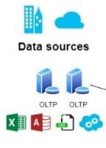
Powerful AI models
Data
Integration
Data
Engineering
Data Warehouse
Data Science
& ML
Real-Time
Data
Business
Intelligence
Data Monitoring
and Action
The finish line: A unified, intelligent data estate built on an open and governed data lake house
Sales
Marketing
Human
Resources
Unified data foundation
Operations
Finance
Sustainability
Virtualized or mirrored data sources
Azure
Data Lake Storage
Google Cloud Storage
Amazon S3
Dataverse
Snowflake
Azure
CosmosDB
Azure
SQLDB
Mongo
DB
Cloud providers
Databases
All other sources
Persistent data governance and security
Notes:
To lay the foundation for long-term success, organizations need a unified, intelligent data estate that’s built on an open and governed data lake house.
Organizations should easily and seamlessly be able to connect all their data sources in one place, protected by a secure and federated governance approach. With built-in, self-service analytics tools, all employees can be empowered to extract more value from their data, whether it’s through advanced data preparation, exploration, transformation and modeling, or through seamless sharing and visualizations of data, and insights embedded in the applications used by teams every day.
With a unified and intelligent data estate, companies can accelerate insight discovery while transforming their data for successful AI innovation.
With the launch of Microsoft Fabric, Microsoft has embraced an open and governed lakehouse as the underlying SaaS storage, standardizing on Delta Parquet format—the same format Azure Databricks customers are using today.
With this evolution of the Unify Your Intelligent Data and Analytics Platform solution play, customers can choose the analytics capabilities from Microsoft Fabric and Azure Machine Learning that work best for their scenarios—without worrying about reshaping their data.
Fabric is also natively integrated with Microsoft Purview, so you and your customers can work with a robust toolset for information protection, data loss prevention, and auditing.
This means that Azure will continue to be the best destination for Analytics and AI workloads.

Slide 15
Activate your data for AI innovation
1
2
3
Unify your data estate
Transform data for powerful AI solutions
Empower everyone with analytics and insights
4
Seamlessly govern and protect
Notes:
Unify your enterprise data estate and centralize and curate all your business data within a single, governed hub, streamlining the analytics process for responsible data discovery and usage.
Transform data for powerful AI solutions and reduce the time and effort it takes to unlock insights from your data using natural language and custom generative AI solutions to streamline the development of machine learning and artificial intelligence models by building them on a lake-based data architecture.
Empower everyone with analytics and insights by providing them with self-service analytics tools to expedite innovation and the discovery of new revenue opportunities thanks to the facilitation of near real-time insights.
Seamlessly govern and protect by responsibly democratizing data while providing industry-leading layered security, governance, and compliance capabilities to accelerate value creation without compromising protection.

Slide 16
Lab 1 : Set Up Fabric

Slide 17
Licences and Capacities
Power BI Pro
Power BI Premium
Microsoft Fabric
(pay-as-you-go)
Microsoft Fabric
(reserved instance)
$10.00 USD
user/month
Access Power BI reports shared with you and publish your own for an even bigger impact.
$4,995 USD
capacity/month (P1)
License for your organization to access Microsoft Fabric
$8,409.60 USD
capacity/month (F64)
License for your organization to access Microsoft Fabric
$5,000 USD
capacity/month (F64)
License for your organization to access Microsoft Fabric
Publish and share Power BI reports
Included in Microsoft 365 E5 and Office 365 E5
Includes all features from Pro and Premium Per User
Grants access to the rest of the Fabric workloads
Dynamically scale up or down and pause capacity
Microsoft Azure Consumption Commitment (MACC) eligible
Annual purchase, saving 40.5% over pay-as-you-go prices
Microsoft Azure Consumption Commitment eligible
Notes:
Capacity usage in Fabric is almost identical to capacity usage in Power BI Premium Per Capacity (PPC)
Provision Capacity : A single capacity is providing the compute power for all the Fabric’s workloads
A single capacity typically supports dozens of separate projects simultaneously, each managed in its own workspace
Developers will share a workspace where collaborative development and consumption at scale is managed
When you purchase a PC, you choose the number of CPU cores. The more CPU cores the more load the PC can handle.
The CPU cores are dynamically shared across all applications with no need to pre-allocate by app.
The total consumption of the CPU across all apps cannot exceed the number of cores. CPU overload causes throttling.
The capacity units are dynamically shared across all the Fabric workloads, with no pre-allocation necessary.
CAPACITIES ARE A SAAS RESOURCE
Capacities are a self-managed system that alleviates day-to-day or hour-to-hour resource management by admins.
Bursting allows all jobs and queries to always run at peak performance regardless of any other compute activity happening on the capacity
Auto scale can automatically adjust the compute units provisioned to the capacity

Slide 18
Workspaces
Data
Factory
Data
Engineering
Data
Warehouse
Data
Science
Real-Time
Intelligence
Power
BI
Partner &
Industry
workloads
Databases
Workspace A
Workspace B
Workspaces can be thought of as folders within OneLake
Contains all items
Reports, Lakehouses, etc.
Set up users and Permissions
Objects can be shared across workspaces

Slide 19
Fabric Persona and Workloads

Slide 20






Persona Optimized Workloads
Data
Factory
Unify your data estate with a data integration experience and 300+ data transformations to easily solve the most complex ETL
scenarios
Data
Engineering
Enable data engineers to design, build, and maintain infrastructures at scale using World-class Spark platform with great authoring
experiences to
Data
Warehouse
Provide industry-leading SQL performance and scale, fully separating compute from storage for independently scaling and natively
storing data in open Parquet/Delta Lake
Data
Science Empower data scientists and analysts to quickly build, deploy, and operationalize sophisticated AI directly within Fabric
Real Time
Intelligence
Ingest streaming data with high granularity, dynamically transform streaming data, query data in real-time for instant insights, and
trigger actions
Power BI Make better, data-driven decisions with the world’s leading business intelligence platform that turns unrelated sources of data into
coherent, interactive insights
Notes:
Data Engineering Data Warehousing Data Integration Data Science Data Visualization Data Management and Data Security
Workloads are designed to target specific personas and tasks, yet work together seamlessly in a unified platform
via OneLake to enable creators to collaboratively do their best work
Data Engineering
Data Warehousing

Slide 21
Overview of OneLake

Slide 22
Data Lake
Data Warehouse
Structured, semi-structured, unstructured data | Structured data
Relational, non-relational | Relational
Schema on read | Schema on write
Easy to scale at a low cost | Difficult and expensive to scale
Machine learning, predictive analytics, real-time analytics | Use Case : Core reporting, BI
Data Lake and Data Warehouse
Notes:
https://azure.microsoft.com/en-us/resources/cloud-computing-dictionary/what-is-a-data-lake#:~:text=risks%20more%20efficiently.-,What's%20the%20difference%20between%20a%20data%20lake%20and%20a%20data,as%20specific%20BI%20use%20cases.

Slide 23



OneLake for all data
“The OneDrive for data” _{for}^{OneDrive}
OneLake
for data
documents
OneLake provides a data lake as a
service without you needing to build it
Notes:
Breaks down Data Silos
SaaS
Lake-centric architecture that offers a unified environment for data professionals and business leaders to work together
Merges storage from various regions and cloud platforms into one logical lake, minimizing data duplication or movement
Just as Office apps are naturally connected to OneDrive, Fabric’s compute engines function with OneLake to read and write data
OneLake is tenant-wide, meaning there is only a single OneLake per tenant
Within OneLake, data connectivity across workspaces within the tenant is automatically enabled allowing for cross-workspace workloads
OneLake is constructed on Azure Data Lake Storage (ADLS)
Supports structured and unstructured data formats such as Delta, Parquet, CSV, and JSON
Workspaces and artifacts for different data domains, contribute to building the same data lake
Without data movement, data from different domains can be analyzed, blended and transformed together
Data is secured and governed in one place while remaining easily discoverable and accessible to all who should have access across the organization
Data can be certified by domain experts to enabling trust for data which is discovered

Slide 24
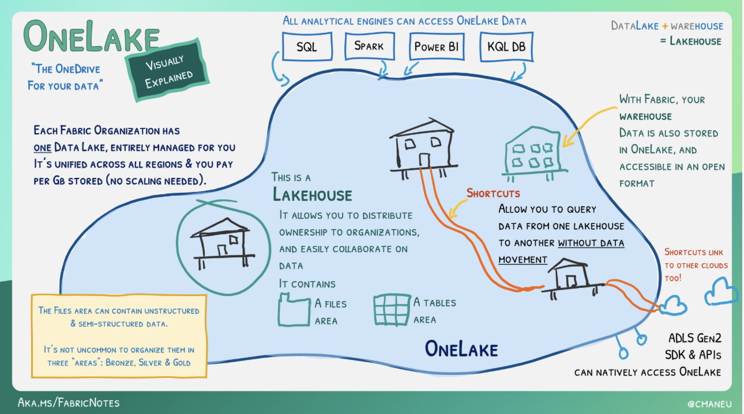
Working with a Fabric One Lake
Notes:
Data platform designed to store, manage, and analyze both structured and unstructured data
Appears as a database built on a data lake using Delta tables
Merges SQL-based analytics of a data warehouse with a data lake's scalability and flexibility
Stores all data formats and can be used with various analytics tools as well as programming languages

Slide 25
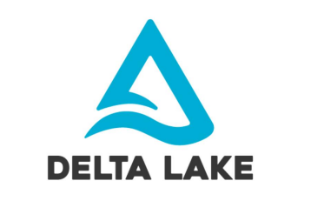
What is
Delta Lake?
Time Travel
File Format
Table-like properties
Native storage for Fabric
Notes:
For structured data, Fabric's analytics engines save data in the delta-parquet format, ensuring smooth interaction across all engines

Slide 26
Shortcuts enable you to create unified data experiences across domains, clouds and accounts.
Enable One Copy
Pointers to other storage locations
Shortcuts
Virtualization
Shared Security
Notes:
With shortcuts, data throughout OneLake can be composed together without requiring data movement
Shortcuts are references (pointers) directing to other files or storage points for data visualization
Shortcuts also support data already in Azure, and other clouds, without creating a copying, making OneLake a multi-cloud data lake
Mirroring provides a low-latency replication option for data from sources such as Azure SQL, Azure Cosmos, and Snowflake database environments

Slide 27
Spark Managed
All About Files
The Data Lakehouse
The Center of Gravity
Structured and Unstructured Data
Similar but distinct from
Warehouse
Notes:
Separation of Compute and Storage
Independently Scale
Bring Compute to the Data
Increased Data Storage Control ; File Type, Location, Redundancy Etc
Decreased Cost
Speed to Analytics : Moving Data Can be expensive and Time Consuming
Data Lakehouse = Open Table Format (Delta, Hudi, Iceberg) + Data Warehouse Modeling + Flexible and Scalable Compute (Spark)

Slide 28
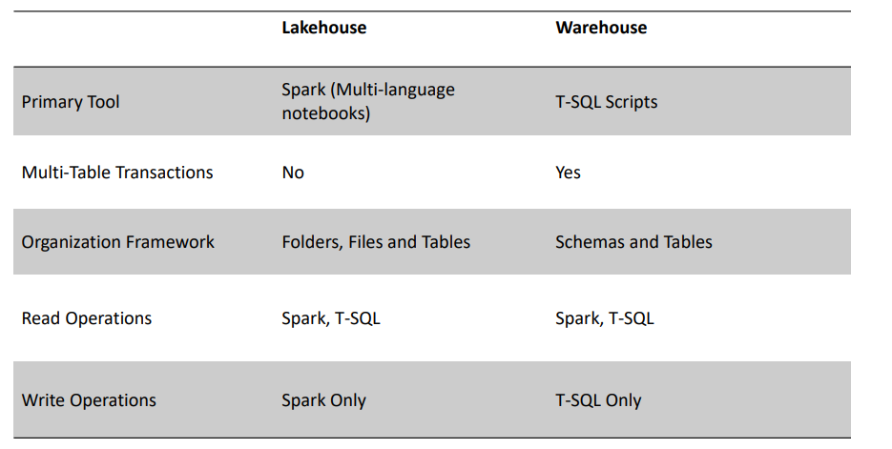
Data Lakehouse vs Data Warehouse

Slide 29
Lab : Setting Up and Navigating The Lakehouse
Notes:
Each Lakehouse in a Fabric-enabled workspace consists of three main elements:
Lakehouse: Storage and metadata section used to engage files, folders, and tables
Semantic Model (default): Auto-generated data model derived from the tables in the Lakehouse
SQL Analytics Endpoint: Provides a read-only SQL interface, allowing users to connect and query data using T-SQL
USING THE LAKEHOUSE EXPLORER : Allows for loading, browsing, and previewing data elements within the Lakehouse
Lakehouse Explorer: Provides a preview of tables and files in the lakehouse
Ribbon: Enables creation of notebooks and semantic models as well as the capture new data using shortcuts, dataflow gen2, pipelines, and event streams

Slide 30
Loading Data Techniques into Lakehouse
1
2
3
4
Directly upload local files or folders to the Lakehouse
Utilize Power Query Online with Dataflows (Gen2) to import and transform data from various sources, providing a visual transformation representation
Use Data Factory Pipelines to copy data and coordinate data processing tasks such as orchestrating Spark, Dataflows, and other control flow logic
Establish connections to external storage solutions, such as OneLake, Azure Data Lake Store Gen2, Amazon S3 and S3 compatible sources for seamless integration into your Lakehouse
Notes:
Developers can use interactive Notebooks to directly read from, transform, and write data to the lakehouse in the form of tables or files
Every Fabric lakehouse is equipped to utilize Spark pools for data processing in files and tables using Scala, PySpark, or Spark SQL
On-demand or scheduled Spark Job Definitions can also employ the Spark engine for data processing within the lakehouse
Read-only SQL analytics endpoints allow you to execute T-SQL commands to query, filter, aggregate, and explore data stored in the lakehouse tables

Slide 31
Lab : Ingest Data Into your Lakehouse and Create Views
Notes:
Data Engineer Roles

Slide 32
Experiences :
Building a Semantic Model
Building a Classification Model

Slide 33
Build with the TM: Creating a Power BI report from Fabric data

Slide 34
Labs Flow
Create A Workspace
Create A Lakehouse
Utilize a Notebook
Utilize a SQL Endpoint
Build a semantic model
Querying & Report Building
Build a BI Dashboard

Slide 35
SQL Endpoint
Notebooks
- SQL Query
Visual Queries
Pyspark
Pandas
Total Sales
select sum(SALES) as total_sales
from sample_sales;
Total Sales per Year
SELECT YEAR_ID, SUM(SALES) AS total_sales
FROM sample_sales
GROUP BY YEAR_ID
ORDER BY YEAR_ID;
Total Sales by Deal Size
SELECT DEALSIZE, SUM(SALES) AS total_sales
FROM sample_sales
GROUP BY DEALSIZE;

Slide 36













Power BI: The bridge between data and decisions
Consumption
Microsoft Fabric
Web
OneLake
Mobile
Interactive reports,
real-time dashboards,
and paginated reports
Embedded
Data Warehouse
OneLake
Custom visualizations
Copilot
AI-infused insights and intuitive
data exploration using natural
language query
Teams
Power BI
service
PowerPoint
Sharing and collaboration
SharePoint
Lakehouse
Excel
Powered by AI with Copilot in Microsoft Fabric
“…”

Slide 37
Semantic Model
A semantic model is a structured representation of your data that sits between the raw data and your reports. It defines how your data should be understood, organized, and queried.
We’ll have two primary table types: fact tables and dimension tables.
Fact Tables:
These tables store numerical data (measures) like sales amounts, costs, revenue, etc.
They are typically large and grow over time as new data is added.
Dimension Tables:
These tables provide descriptive attributes about the business entities that are referenced in fact tables.
Examples include customer details, product information, or time periods.
What Does a Semantic Model Contain?
Tables: Usually pulled from data sources like a data lake, SQL database, or Excel files.
Relationships: Connections between tables (e.g., Sales table linked to Customers table).
Measures: Business calculations written in DAX (e.g., Total Sales, Average Order Value).
Calculated Columns / Tables: Derived values that enrich the data model.
Metadata: Friendly names, hidden columns, data types, and formatting.

Slide 38
Bike Sales Dataset
The Bike Sales Dataset is a fictional but realistic representation of a retail business that sells bikes and related products through multiple stores and to various customers.
This dataset captures the entire sales process — from products being sold to customers buying them, including store locations, staff involved, and transaction details like price and discount.
Table | Type | Description
Order items | Fact Table | Contains individual sales transactions including quantity sold, price, discount, and foreign keys to customer, product, store, and staff. This is the main fact table used to calculate revenue, discounts, and sales volume.
products | Dimension Table | Stores details about each product sold, including name, model year, list price, and links to brand and category.
customers | Dimension Table | Holds customer information such as names, contact details, city, and state. Helps analyze sales by demographics or region.
stores | Dimension Table | Contains information about each store location including name, address, and region. Useful for comparing store performance.
staffs | Dimension Table | Lists employees who made sales or managed stores. Includes their names, email, roles, and linked store.
orders | Dimension Table | Captures each order's date and status. Connects one or more items (from the sales table) to a single transaction.
brands | Dimension Table | Lists the bike brands. Linked to the products table. Helps in brand-level analysis.
categories | Dimension Table | Stores product categories like “Mountain Bikes” or “Road Bikes”. Useful for segmenting sales by type.

Slide 39
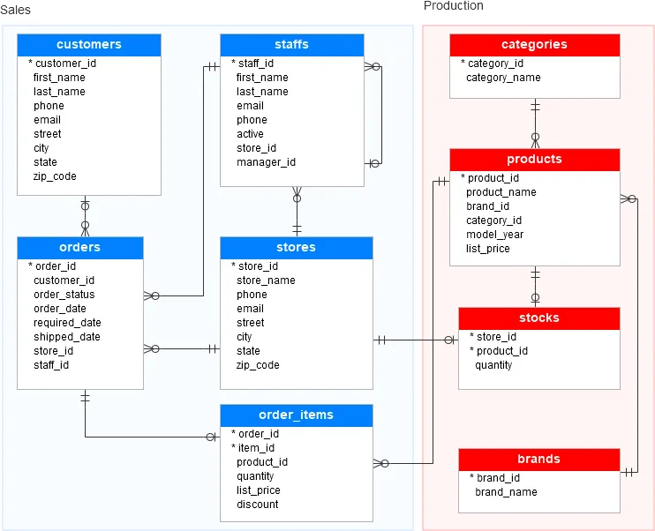

Slide 40
Relationship Modelling
Table A | Column (A) | Table B | Column (B) | Cardinality | Why This Relationship Exists
orders | customer_id | customers | customer_id | Many-to-One | Each order is made by one customer, but a customer can make many orders.
order_items | order_id | orders | order_id | Many-to-One | Each order item belongs to one order, but an order can contain many items.
order_items | product_id | products | product_id | Many-to-One | Each order item refers to one product, and a product can appear in many orders.
products | brand_id | brands | brand_id | Many-to-One | Each product is made by one brand, but a brand can have many products.
products | category_id | categories | category_id | Many-to-One | Each product belongs to one category, but a category can contain many products.
products | store_id | stores | store_id | Many-to-One | Each product is stored at one store, but a store can stock many products.
orders | staff_id | staffs | staff_id | Many-to-One | Each order is handled by one staff member, but a staff member can handle many orders.
orders | store_id | stores | store_id | Many-to-One | Each order is made at one store, but a store can process many orders.
staffs | manager_id | staffs | staff_id | One-to-One / Self-Join | Each staff member can be managed by one manager, and a manager may oversee multiple staff. This is a self-referencing relationship.
staffs | store_id | stores | store_id | Many-to-One | Each staff works at one store, but a store employs many staff members.

Slide 41
Measures
1. Total Sales
Purpose:
Show the total revenue generated by all bike orders.
2. Total Orders
Purpose:
Count how many orders have been placed.
Total Sales =
SUMX(
order_items,
order_items[list_price] * (1 - order_items[discount]) * order_items[quantity])
Total Orders = DISTINCTCOUNT(orders[order_id])
3. Average Order Value
Purpose:
Show the average sales amount per order.
4. Sales by Product Category
Purpose:
Show which product categories bring in the most revenue.
Average Order Value = DIVIDE([Total Sales], [Total Orders])
5. Sales by Customer State
Purpose:
See sales distribution across states.
6. Sales Trend by Order Date
Purpose:
Show sales trend over time by month.

Slide 42
Your Take Home Assignment

Slide 43
Bonus : Data Governance with MS Fabric

Slide 44









Microsoft Purview: Bringing data security, governance, and compliance together
For information and cybersecurity teams
Data Loss Prevention
Insider Risk Management
Information Protection
Data Security
Data Governance
For data consumers, data engineers, data officers
Data Map
Data Catalog
Data Estate Insights
Microsoft Purview
Risk & Compliance
Data Lifecycle Management
eDiscovery & Audit
Communication Compliance
For risk, compliance, and legal teams
On-prem and multi-cloud
Unstructured & structured data
Across IaaS, and SaaS
Notes:
Microsoft Purview is the solution for comprehensive data governance, security, and compliance on ALL your data wherever it lives. The new Microsoft Purview combines our solutions for Data Security (for security leaders), Data Governance (for data officers and consumers) and Data Compliance (for risk leaders) into one unified experience and a unified underlying platform.

Slide 45

Unify analytics and governance with Fabric and Purview
Microsoft Fabric
Microsoft Purview
Reshape how you access, manage, and act on data and insights by connecting every data source and analytics service together in Fabric
Keep your data safe and governed with unified data governance, information protection, and risk and compliance solutions
Data ownership
Unmatched security & compliance
Unified governance

Slide 46






Gain full visibility and control with Microsoft Purview
Governance and security features built into Fabric
Estate-wide governance
and security with
Microsoft Purview
Manage your
data estate
Admin portal
Tenant and workspace
settings
Metadata scanning
Capacities
Domains
Workspaces
Secure, protect,
and comply
Fabric inbound and
outbound security
Conditional access
Fine-grained security and
access controls
Workspace & item
security
Data encryption
Purview sensitivity labeling**
Certificates & standards
Encourage data
discovery, trust, and use
OneLake data hub
Endorsements
Data lineage & impact
analysis
External data sharing
Metadata curation
Discover & Reuse
Monitor, uncover
insights, and act
Admin monitoring
Capacity metrics
Monitoring hub
Purview Hub
Fabric
metadata
Comprehensive
data security
Federated data
governance
Advanced
Govern
and secure
Fabric data
Risk &
compliance
posture
Data residency
Purview Audit**
Fabric integrated with Microsoft Purview
**Additional Microsoft Purview purchase required

Slide 47
Appendix

Slide 48





Data Factory workload
Dataflows and data pipelines bring together low-code, AI-based experiences, multi-cloud connectivity, and
persistent data security and governance to help solve complex ETL scenarios for all developers
200+ native data source connectors
300+ data transformations in dataflows
designer to transform data more easily
Cloud-scale data movement with Data
Factory
Low-code interface for ingesting data
from hundreds of data sources using
Dataflows Gen2
Out-of-the-box rich data orchestration
capabilities to compose flexible workflows
Powerful, enterprise-grade Data Factory
workload with the best of ADF and Power
Query together
Data
Factory
Data
Engineering
Data
Warehouse
Data
Science
Real-Time
Intelligence
Power
BI
Partner &
Industry
workloads
Copilot in Microsoft Fabric
OneLake
Security, Governance and Administration with Purview

Slide 49

Data Engineering workload
Build your data estate and empower data engineers with a world-class Spark platform, fully integrated with
Data Factory, to transform and maintain infrastructures at scale
Pro and low-code authoring experience
Schedule and orchestrate data
transformations with notebooks and
Spark jobs
Use notebooks to write code for data
ingestion, preparation, and transformation
Launch clusters on demand and
dynamically scale in, scale out, pause, and
resume
Perform code-free interactive data
exploration and add to your data pipeline
Data
Factory
Data
Engineering
Data
Warehouse
Data
Science
Real-Time
Intelligence
Power
BI
Partner &
Industry
workloads
Copilot in Microsoft Fabric
OneLake
Security, Governance and Administration with Purview

Slide 50

Data Warehouse workload
Achieve data platform goals with ease and cost efficiency, while empowering your developers and engineers of
any skill level with accelerated reporting and insights
Industry-leading SQL performance and
scale
Fully separate compute storage that can
independently scale
Data
Factory
Data
Engineering
Data
Warehouse
Data
Science
Real-Time
Intelligence
Power
BI
Partner &
Industry
workloads
Copilot in Microsoft Fabric
Natively store data in open
Parquet/Delta Lake
OneLake
TLS 1.2 encryption protects connections
for granular security across data platform
Security, Governance and Administration with Purview
Cross-database querying for fast insights
and zero data duplication

Slide 51

Data Science workload
Build, deploy, and operationalize sophisticated AI and ML models with speed and at scale from your Lakehouse
Access data from multiple sources and
store data and insights in Lakehouse(s)
Leverage data science capabilities for
model prediction at scale Iterate, build,
and track machine learning experiments
using ML flow
Data
Factory
Data
Engineering
Data
Warehouse
Data
Science
Real-Time
Intelligence
Power
BI
Partner &
Industry
workloads
Copilot in Microsoft Fabric
Perform exploration, experimentation,
modeling, featurization and serving
of predictive insights by leveraging
built-in experiences
Collaborate with others via Notebook,
Power BI, and Lakehouses in real-time
OneLake
Security, Governance and Administration with Purview

Slide 52

Real-Time Intelligence workload
Explore data and turn insights into actions by performing real-time analysis across telemetry data to better
predict, optimize, and improve data applications
Ingest, transform, query, visualize, and act
on data in real time.
Data
Factory
Data
Engineering
Data
Warehouse
Data
Science
Real-Time
Intelligence
Power
BI
Partner &
Industry
workloads
Simple ingestion, curation and processing
of streaming data in the Real-Time Hub, a
single data estate for data in motion.
No-, low-, and pro-code experiences
for everything from business insight
discovery to complex stream processing.
Create triggers on changing data to act
automatically when conditions are met.
Streamline analysis of event streaming
data with Copilot in Fabric.
Copilot in Microsoft Fabric
OneLake
Security, Governance and Administration with Purview

Slide 53

Power BI workload
Uncover powerful insights with intelligence visuals, leverage data quickly and intuitively, and help achieve faster
and better, data-based decisions with the industry-leading Power BI platform
Easy-to-use drag and drop canvas and
visualizations for insightful and engaging
report-building in seconds
Data
Factory
Data
Engineering
Data
Warehouse
Data
Science
Real-Time
Intelligence
Power
BI
Partner &
Industry
workloads
Native Integration with Microsoft 365
Copilot in Microsoft Fabric
Built-in AI capabilities and visuals
illuminate hidden patterns, opportunities
and anomalies with the click of a button
Connect to, index, and certify datasets in
the Power BI data hub
Build governed databases, like data
models or data marts, in a trusted and
secure hub
OneLake
Security, Governance and Administration with Purview

Slide 54

Copilot in Microsoft Fabric
Use conversational language with Copilot in Fabric to create dataflows and pipelines, write SQL statements, build
reports, and even build machine learning models
Chat with AI assistant and request help
handling data analysis
Code more efficiently with intelligent
code completion and generated code
explanations
More quickly enrich, model, analyze, and
explore data all through natural languages
Create Power BI reports automatically and
summarize your insights for streamlined
productivity
Access industry-standard code templates
to facilitate building robust data pipelines
Data
Factory
Data
Engineering
Data
Warehouse
Data
Science
Real-Time
Intelligence
Power
BI
Partner &
Industry
workloads
Copilot in Microsoft Fabric
OneLake
Security, Governance and Administration with Purview

Slide 55
Unified data foundation with OneLake
Manage and analyze all your data across your organization in a unified, secure, and centralized SaaS data lake
for everyone with OneLake––the “OneDrive” for data
A single and open, logical SaaS lake for
the whole organization
OneLake supports any type of file,
structured or unstructured
One copy of data for use with multiple
analytical engines
Enable virtualization of data without
duplication using shortcuts
All workloads automatically store their
data in OneLake in Delta Parquet format
Data in OneLake is automatically indexed
for discovery, sharing, governance, and
compliance
Data
Factory
Data
Engineering
Data
Warehouse
Data
Science
Real-Time
Intelligence
Power
BI
Partner &
Industry
workloads
Copilot in Microsoft Fabric
OneLake
Security, Governance and Administration with Purview

Slide 56
Security, Governance and Admin in Microsoft Fabric
Manage, secure, and govern all your data in Microsoft Fabric and beyond
Reduce the effort needed to defend and
control your entire analytics platform with
out-of-the-box security and governance
Secure your network from any intrusion,
ensure only the right people have access
to the right data, and maintain compliance
with even the strictest requirements​
Enable different parts of the organization
to take ownership of their data while still
contributing to the same data lake ​
Certify datasets to promote usage of
the most accurate data across the
organization
Maintain the flexibility to use the partner
and third-party solutions you want​
Data
Factory
Data
Engineering
Data
Warehouse
Data
Science
Real-Time
Intelligence
Power
BI
Partner &
Industry
workloads
Copilot in Microsoft Fabric
OneLake
Security, Governance and Administration with Purview

Slide 57
















Lakehouse tutorial
https://learn.microsoft.com/en-us/fabric/data-engineering/tutorial-lakehouse-introduction
Data Science tutorial
https://learn.microsoft.com/en-us/fabric/data-science/tutorial-data-science-introduction
End-to-end
tutorials
Real-Time Analytics tutorial
https://learn.microsoft.com/en-us/fabric/real-time-analytics/tutorial-introduction
Data warehouse tutorial
https://learn.microsoft.com/en-us/fabric/data-warehouse/tutorial-introduction
Power BI tutorial
https://learn.microsoft.com/en-us/power-bi/fundamentals/fabric-get-started
Data Factory tutorial
https://learn.microsoft.com/en-us/fabric/data-factory/tutorial-end-to-end-introduction

Slide 58
End…

